Slide 1

Docker and Azure
Steve Lasker
Program Manager
Microsoft Azure Developer Experiences

Slide 2





Our Sun
Pluto

Slide 3
Foot
Beating
Forestay
Nun
In Irons
Packing Gland
Seacock
Skeg
Singlehanded
Spreader
Whip
Whisker Pole
Close Hauled
Roach
Puff
Sheave
Luft
Cunningham
Hard-A-Lee
Vang
Can
Sole
Vee-berth
Clew
Tack
Jacklines
Toppinglift
Beam Reach
Jive
Lazy Sheet
Bear Away
Broad Rach
Weather Helm
Port
Starboard
Give Way Vessel
Stand On Vessel

Slide 4
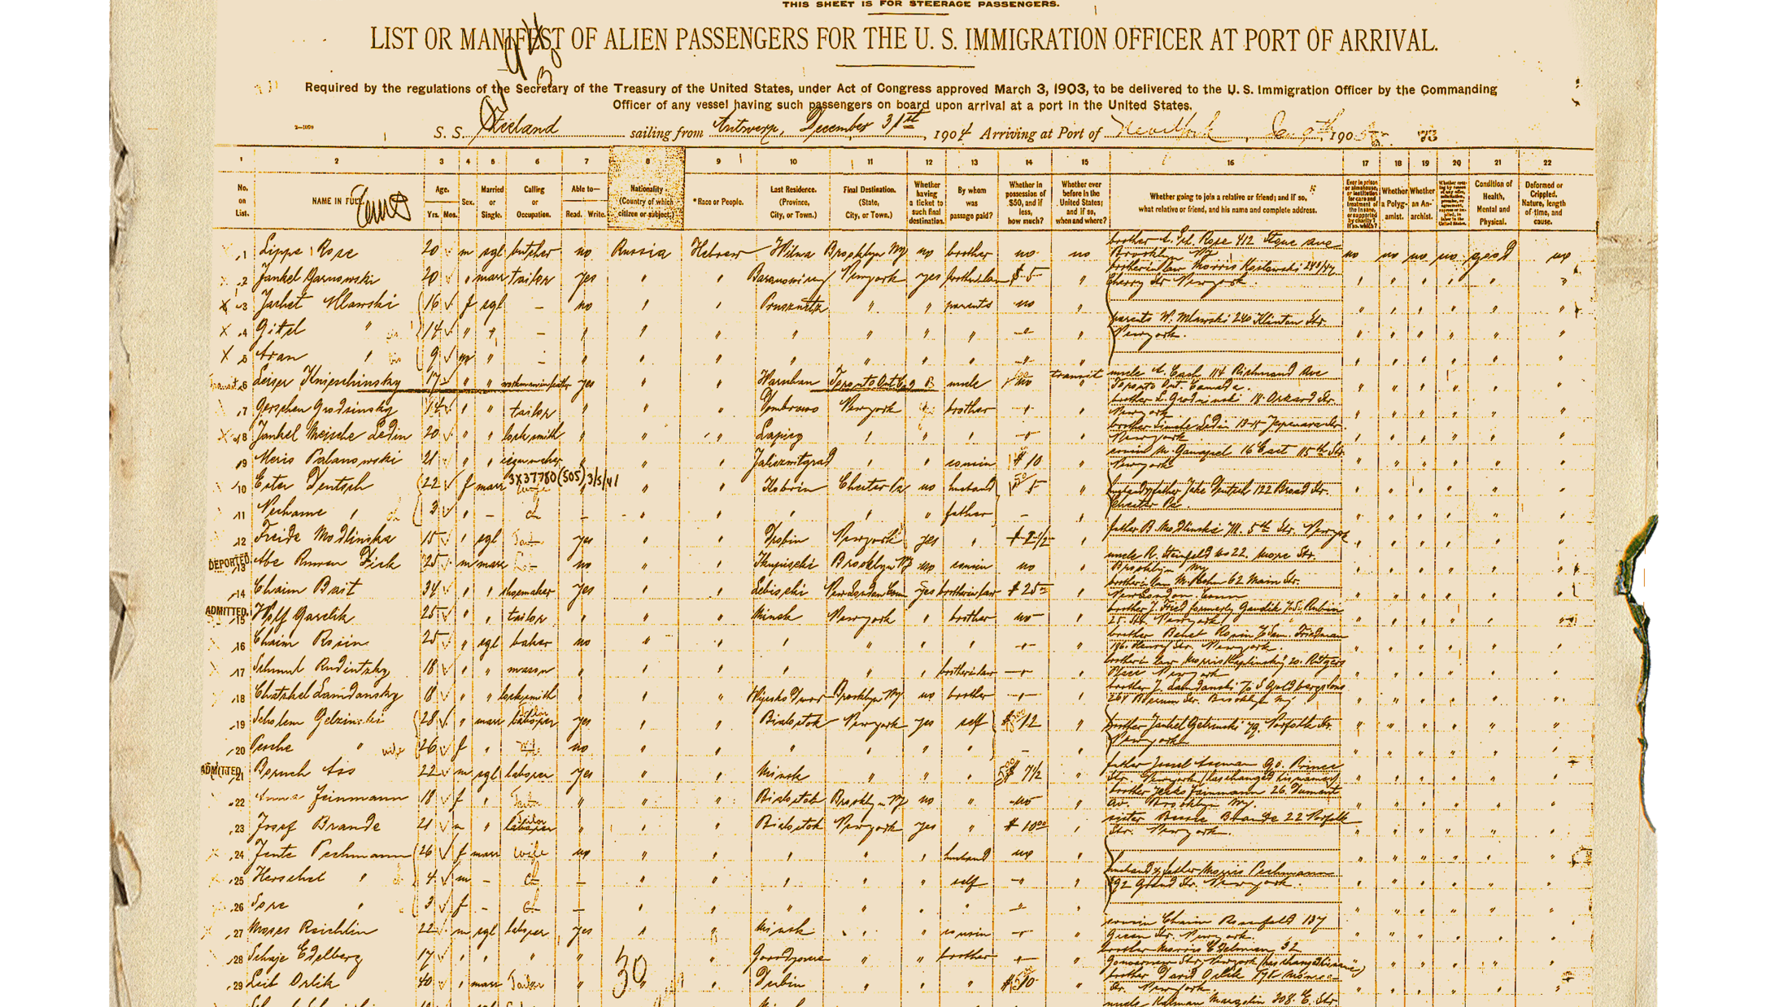
Shipping Manifest
Big Picture for working with Containers
Container Vocabulary
Container Architecture
Micro Services and Containerization
ASP.NET Core
Visual Studio
Visual Studio Team Services
Azure Container Service

Slide 5

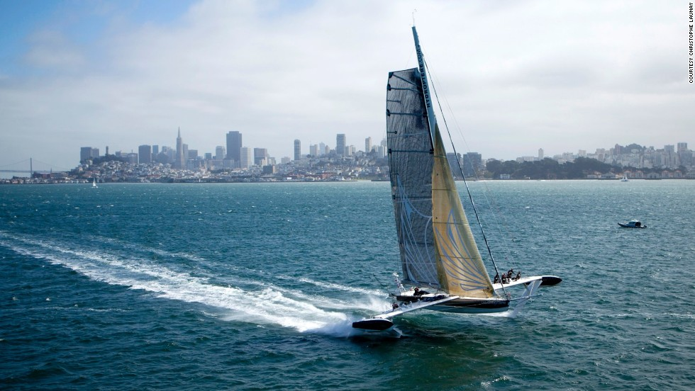
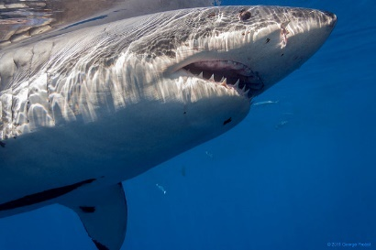
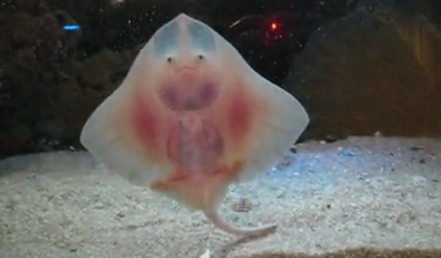
Notes:
We’re going to cover many topics, provide an overview of the end to end experience
There will be interesting things along the way, not all of which we’ll have time to dig into

Slide 6
Container Lingua Franca
Vocabulary
Agent
Client
Compose
Container
Dockerfile
Host
Image
Master
Orchestrator
Registry
Scaffold
Scheduler
Slave
Tag
Volume
Layers
Labels
Registry
Swarm
Container Services
Tags
Service
Ports
Commands
Docker-Machine Create, Env, Ip, Start, Restart, Active
Docker build, login, pull, push, run, search, tag
Docker-Compose Up, Build, Scale

Slide 7

Docker Containers and VMs
Host OS - Hardware
Hyper Visor
Guest OS #1 (Virtual Machine)
Guest OS #2 (Virtual Machine)
Guest OS #3
Docker Daemon

Slide 8
App A
App A’
App B
Containers are isolated, but share OS and, where appropriate, bins/libraries
Bins/Libs
Bins/Libs
Bins/Libs
Guest OS
Guest OS
Guest OS
App A
App A’
App B
App B’
App B
App B’
App B
App B’
Bins/Libs
Bins/Libs
Hypervisor
Docker Engine
Host OS
Host OS
Server
Server

Slide 9
Demo
PS docker run -it busybox
Unable to find image 'busybox:latest' locally
latest: Pulling from library/busybox
f810322bba2c: Already exists
a3ed95caeb02: Already exists
Digest: sha256:97473e34e311e6c1b3f61f2a721d038d1e5eef17d98d1353a513007cf46ca6bd
Status: Downloaded newer image for busybox:latest
/ # ls
bin dev etc home proc root sys tmp usr var
/ # ps
PID USER TIME COMMAND
1 root 0:00 sh
8 root 0:00 ps
/ # cd usr
/usr # touch a
/usr # touch b
/usr # touch c
/usr # ls
a b c sbin
/usr

Slide 10
Cool, but where did busybox come from?

Slide 11
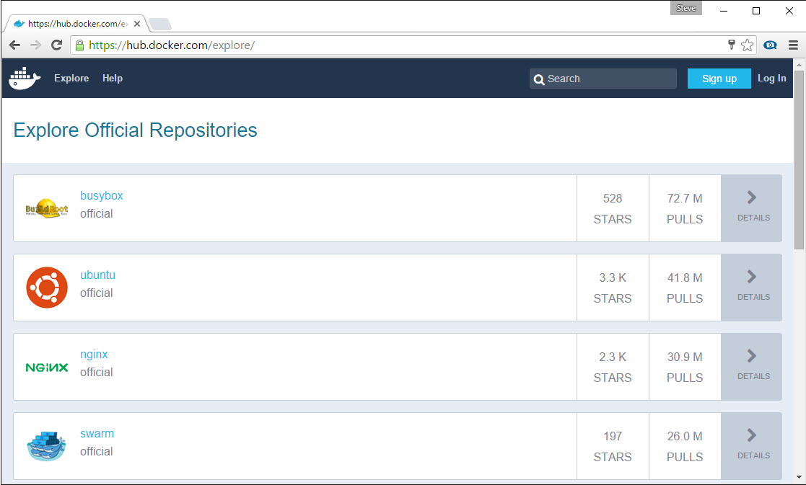
Docker Registry
Stores docker images
Searchable
Public Registry – Hub.Docker.com
Private Registries – Instanced for you
Can be hosted in Docker, Azure, AWS, Google, …

Slide 12
Demo
PS docker search microsoft
NAME DESCRIPTION STARS OFFICIAL AUTOMATED
microsoft/aspnet ASP.NET is an open source server-side Web ... 372 [OK]
mono Mono is an open source implementation of M... 119 [OK]
microsoft/azure-cli Docker image for Microsoft Azure Command L... 36 [OK]
suchja/wix Creates installer packages (MSI) for Micro... 2 [OK]
microsoft/applicationinsights Application Insights for Docker helps you ... 2 [OK]
sequenceiq/azure-cli-tools Command line tool to deploy the MicrosoftD... 1 [OK]
microsoft/oms Monitor your containers using the Operatio... 1 [OK]
PS docker pull microsoft/dotnet
357ea8c3d80b: Already exists
52befadefd24: Already exists
3c0732d5313c: Already exists
e6e56418a7e4: Pull complete
cff52ced559d: Downloading [=========> ] 9.961 MB/51.95 MB
6bf3d7845917: Downloading [=> ] 3.243 MB/82.12 MB
9be54d5ae146: Pull complete
c3abf6246d6a: Pull complete
Digest: sha256:52f60468dd05584c39110313784ba98889d085e175a906c553c61826cd7382d2
Status: Downloaded newer image for microsoft/dotnet:latest

Slide 13
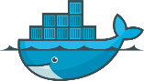










Docker API
Client
DOCKER_HOST
Registry
Docker pull
Docker daemon
Docker run
Containers
Images Cache

Slide 14
Vocabulary
Host A VM running the Docker Daemon to host a collection of Docker Containers
Client Where docker commands are executed ^{(client/server)}
Image An ordered collection of filesystems* to be used when instancing a container ^{– * see layers, later on}
Container A runtime instance of an image
Registry A collection of docker images
Commands
Docker run The process of instancing an Image as a running container
Docker search Searches the current registry
Docker pull Pulls a Docker Image to your Docker Host cache
Understanding the Docker Architecture

Slide 15
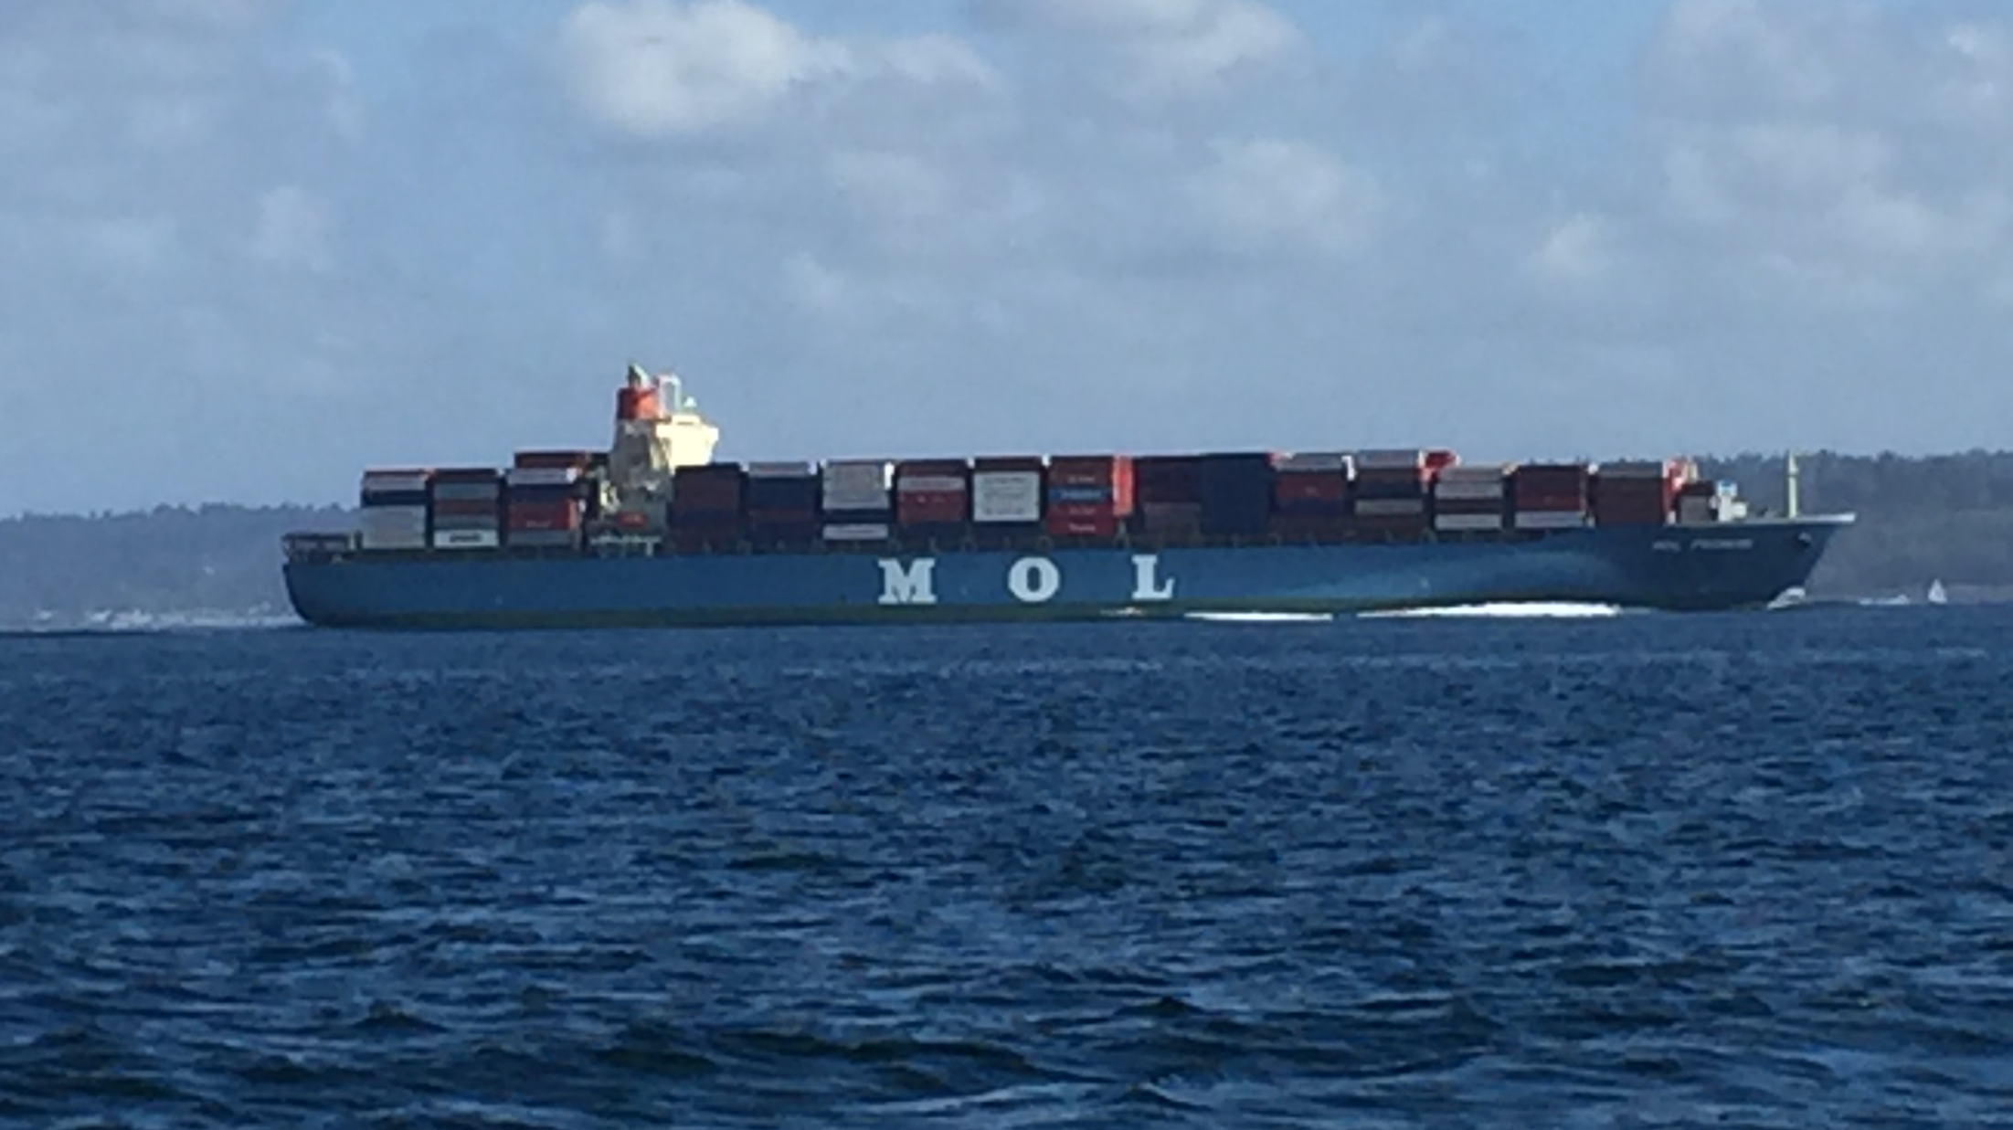
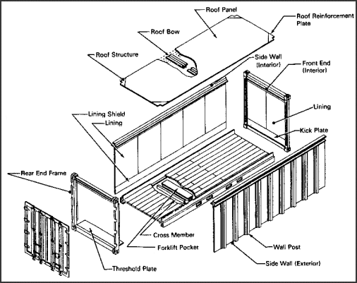
Building Docker Images

Slide 16
Demo - build
PS dotnet new
PS Code .
# add a docker file
PS dotnet restore
PS dotnet build –c release
PS dotnet publish –c release –o app
PS Docker build –t helloworld .
Sending build context to Docker daemon 667.6 kB
Step 1 : FROM microsoft/dotnet:1.0.0-rc2-core
---> c7a9cf9c81f5
Step 2 : WORKDIR /app
---> Using cache
---> eb9360aaf982
Step 3 : COPY /app /app
---> Using cache
---> 80e66eaa09e0
Step 4 : ENTRYPOINT dotnet DotNetHelloWorld.dll
---> Using cache
---> e559e0c38fbd
Successfully built e559e0c38fbd
PS docker images
REPOSITORY TAG IMAGE ID CREATED SIZE
helloworld latest ae30949a3358 5 seconds ago 242.4 MB
PS docker run helloworld
Hello World!
Dockerfile # Use the .NET Core runtime, optimized image
FROM microsoft/dotnet:1.0.0-core
# Set the Working Directory
WORKDIR /app
# Copy the compiled & published app
COPY /app /app
# Start the app
ENTRYPOINT ["dotnet", "HelloWorld.dll"]

Slide 17


Docker build
Registry
DOCKER_HOST
Private Registry
Docker daemon
Containers
Images
dockerfile
FROM microsoft/dotnet:1.0.0-core
WORKDIR /app
COPY /app /app
ENTRYPOINT dotnet HelloWorld.dll
Code/Binaries
0001Program.cs110
HelloWorld.dll
111010111011011010
Client
Docker build
Docker run
Docker push

Slide 18
Demo - push
PS docker login
Username (stevelasker):
Password:
WARNING: login credentials saved in C:\Users\SteveLas\.docker\config.json
Login Succeeded
PS docker tag hellowold stevelasker/helloworld:v1
The push refers to a repository [docker.io/stevelasker/helloworld:v1]
5f70bf18a086: Pushed
30782ae9410d: Mounted from microsoft/dotnet
ca3a6ab52687: Pushed
162da15b5454: Pushing [==========================================> ] 103.5 MB/122.6 MB
162da15b5454: Pushing [================================> ] 9.201 MB/44.41 MB
ddef881aeaff: Waiting
v1: digest: sha256:71acc144df8563d7f319e5c65108490501a8a67364db5517db792d721d92dfc0
# The following can now be run from any client
PS docker run stevelasker/helloworld:v1

Slide 19
Vocabulary
Host A VM running the Docker Daemon to host a collection of Docker Containers
Image An ordered collection of filesystems* to be used when instancing a container
Container A runtime instance of an image
Registry A collection of docker images
Dockerfile Commands to build a Docker image
Tag A version identifier for an image, plus the registry name docker tag [registrypath]/image:[version]
Commands
Docker search Searches the current registry
Docker pull Pulls a Docker Image to your Docker Host cache
Docker run The process of instancing an Image as a running container
Docker login Logs into the registry so you can push images
Docker build Creates an image, using a dockerfile as the definition
Docker tag Renames an image: [registryname]/[user]/[imagename]:[tag]
Docker push Pushes an image to a registry
Understanding the Docker Architecture

Slide 20

Where are we?
Pulled and instanced images
Built our own image
Ran it multiple times ^{on different ports}
Tagged it for the docker registry
Pushed it to a docker registry
A few parking lot issues to cover…

Slide 21
Networking
Host OS
Docker Networking uses NAT to route inbound traffic to each container
Each container can use the same port, internal to it’s container, but must be addressable outside by unique ports per HOST
Load Balancers and Service Discovery are new important topics
Note: networking may vary based on your orchestration engine
eth0: 10.100.2.100
DOCKER_HOST
Docker daemon
docker0: 192.168.1.100
:80
:8001
:8002
:8003
Container1
Container2
eth0: 172.17.0.2
eth0: 172.17.0.3
veth473629a
veth5998974
Container3
Container4
eth0: 172.17.0.4
eth0: 172.17.0.5
veth736321c
veth2726149b

Slide 22
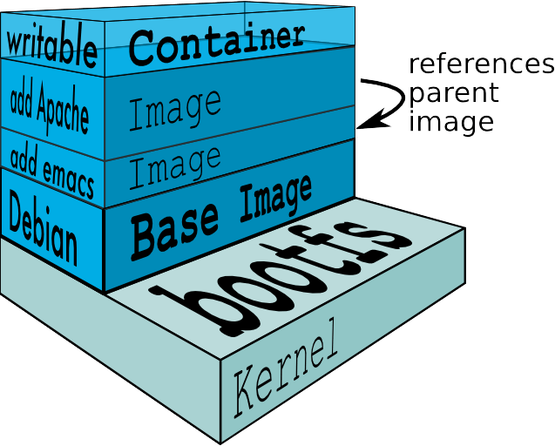
Docker Layers

Slide 23
Persistent Storage
Docker Containers are Immutable
To save data, you must provide external storage
Scenarios:
Logs
Database Files
Inner Loop Development – mounting your source
Volume Drivers

Slide 24
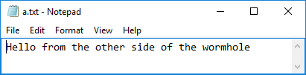
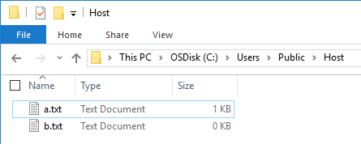

Docker Volume
Docker run -v hostpath:/containerpath
PS docker run -it -v /c/Users/Public/Host:/wormhole busybox
/ # ls
bin dev etc home proc root sys tmp usr var wormhole
/ # cd wormhole
/wormhole # touch a.txt
/wormhole # touch b.txt
/wormhole # ls
a.txt b.txt
/wormhole # cat a.txt
Hello from the other side of the wormhole
/wormhole #

Slide 25
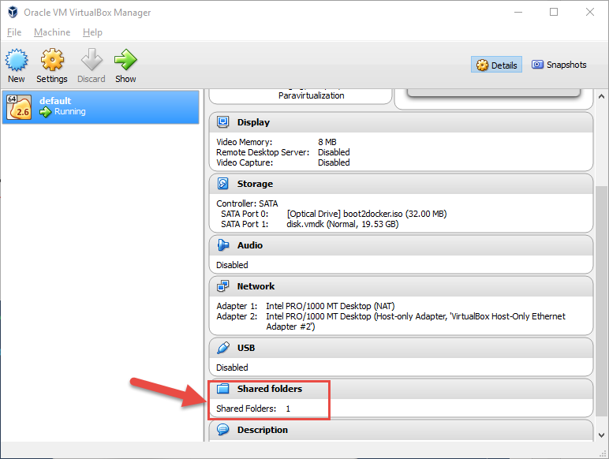
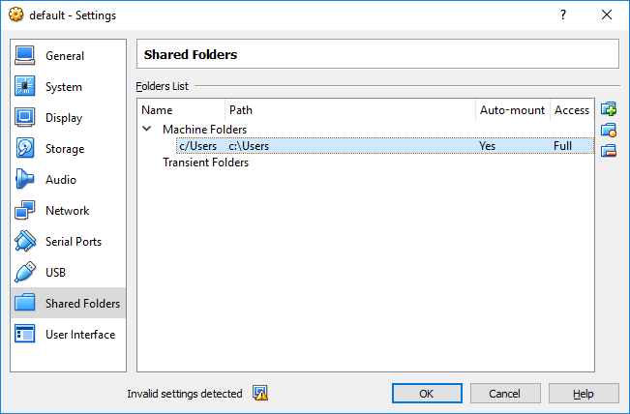
Docker Volume
Using VirtualBox ^{(local)}, be sure to sit below c/Users, and confirm case sensitivity. ^{(Linux)}
Better yet:
Use Docker for Windows/Docker for Mac

Slide 26
Vocabulary
Host A VM running the Docker Daemon to host a collection of Docker Containers
Image An ordered collection of filesystems* to be used when instancing a container – * see layers, later on
Container A runtime instance of an image
Registry A collection of docker images
Dockerfile Commands to build a Docker image
Tag A version identifier for an image
Volume A means to provide persistent storage from an immutable container
Commands
Docker run The process of instancing an Image as a running container
Docker login Logs into the registry so you can push images
Docker build Creates an image, using a dockerfile as the definition
Docker tag Renames an image: [registryname]/[user]/[imagename]:[tag]
Docker push Pushes an image to a registry
Docker run –v h:c Create a wormhole from the host to the container, represented as a volume Refer to docker-compose for common usage scenarios
Docker-compose Volumes

Slide 27
Working with multiple hosts
You have a local Docker HOST local development
Several hosts in Azure Dev/Test labs as part of your isolated development environment
Need to troubleshoot issues in your cluster
How do you maintain and manage the certs for each?

Slide 28

Docker-Machine.exe
Manages your various host configurations
Stored in %USERPROFILE%\.docker\machine\
PS docker-machine ls
NAME ACTIVE DRIVER STATE URL DOCKER
default - virtualbox Running tcp://docker
dockerhost-linux - azure Running tcp://dockerhost-linux.cloudapp.net:2376
PS docker-machine env dockerhost-linux
$Env:DOCKER_TLS_VERIFY = "1"
$Env:DOCKER_HOST = "tcp://dockerhost-linux.cloudapp.net:2376"
$Env:DOCKER_CERT_PATH = "C:\Users\SteveLas\.docker\machine\machines\dockerhost-linux"
$Env:DOCKER_MACHINE_NAME = "dockerhost-linux"
# Run this command to configure your shell:
# Docker-machine env dockerhost-linux | Invoke-Expression
PS docker-machine active
dockerhost-linux
PS docker-machine ip dockerhost-linux
dockerhost-linux.cloudapp.net

Slide 29
Docker-Machine - Create
Provisions Docker Hosts In Azure
Linux for now, Windows Coming
PS openssl req -x509 -nodes -days 365 -newkey rsa:1024 -keyout AzureMgmnt.pem -out AzureMgmnt.pem
PS openssl pkcs12 -export -out AzureMgmnt.pfx -in AzureMgmnt.pem -name "Azure Management Cert"
PS openssl x509 -inform pem -in AzureMgmnt.pem -outform der -out AzureMgmnt.cer
PS docker-machine create -d azure --azure-subscription-id=“[your azure sub id]" --azure-subscription-cert="C:\Users\SteveLas\.docker\AzureCerts\AzureMgmnt.pem" dockerhost-linux
Docker Docs - Docker-machine create -d azure...
Azure Docs - Docker-machine create -d azure ...

Slide 30
Commands
Docker-machine create Provisions a VM with the Docker daemon installed and configured locally for use
Docker-machine env Switches between host entries
Docker-machine ls Lists the currently configured hosts
Docker-machine active The currently configured host
Docker-machine start Starts the named host – required on reboot for VirtualBox
Docker-machine ip Provides the URI for the named host
Docker Docs - Docker-machine create -d azure...
Azure Docs - Docker-machine create -d azure ...

Slide 31
Instancing Multiple Services
How do you instance several different services at the same time?
Are you building Micro Services?
How to manage configurations between environments?

Slide 32

Docker-Compose.exe
API above docker run
Used to instance multiple containers 1:~
Can reference dockerfiles and/or images
Paired with docker-compose.yml

Slide 33
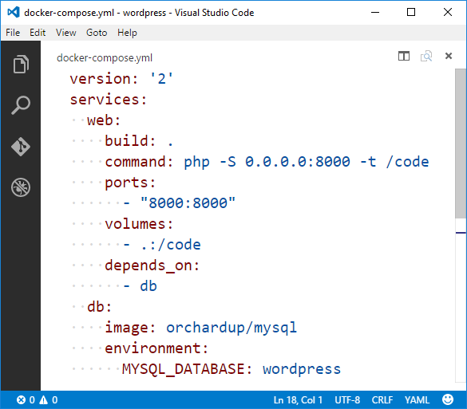
Demo: Compose
PS docker-compose up -d
Pulling db (orchardup/mysql:latest)...
latest: Pulling from orchardup/mysql
...
Status: Downloaded newer image for orchardup/mysql:latest
Creating wordpress_db_1
Building web
Step 1 : FROM orchardup/php5
latest: Pulling from orchardup/php5
...
Digest: sha256:166c2488a7cd60dc02f0cfcb0b606db38ff251f36cb5b10e8b837d9619c41036
Status: Downloaded newer image for orchardup/php5:latest
---> d8e939bb8720
Step 2 : ADD . /code
---> 74ef767963f1
Successfully built 74ef767963f1
Creating wordpress_web_1
https://docs.docker.com/compose/wordpress/

Slide 34



Docker Compose
Docker-compose.yml
Registry
version: '2'
services:
multiservice:
image:
- multiservice:latest
environment:
- CustomerAPIService=http://webapi/api/Customer
ports:
- "80:80"
depends_on:
- webapi
webapi:
image:
- multiserviceapi:latest
DOCKER_HOST
Private Registry
Docker daemon
Multi Service
Multi Service
Containers
Images
Multi Service API
Multi Service
Multi Service API
frontend
Dot Net
api
Multi Service API
Client
Docker-compose

Slide 35
Vocabulary
Host A VM running the Docker Daemon to host a collection of Docker Containers
Image An ordered collection of filesystems* to be used when instancing a container – * see layers, later on
Container A runtime instance of an image
Registry A collection of docker images
Compose define multi-container applications with all dependencies in a single file, then spin up in a single command
Commands
Docker login Logs into the registry so you can push images
Docker build Creates an image, using a dockerfile as the definition
Docker tag Renames an image: [registryname]/[user]/[imagename]:[tag]
Docker push Pushes an image to a registry
Docker-compose up Use a docker-compose.yml file to build and/or run a collection of containers
docker compose

Slide 36
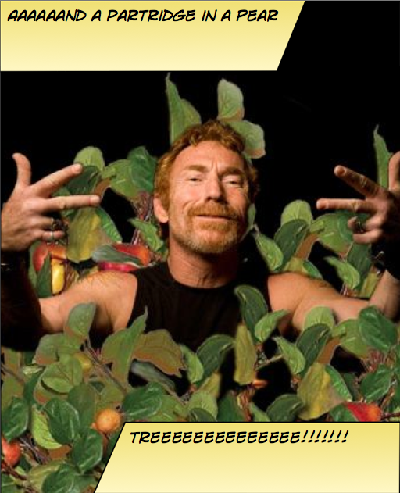
Instancing Multiple Copies
You need:
10 web front ends
8 API instances
4 Redis Cache
1 Database

Slide 37

Web
Web
Web
Web
Web
API
API
API
Cache
Cache

Slide 38
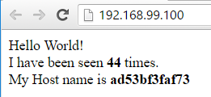
Demo: Scale
PS docker-compose up –d
Creating scale_redis_1
Building web
Creating scale_web_1
Creating scale_lb_1
PS start-process http://192.168.99.100
PS docker-compose scale web=3
Creating and starting 2 ... done
Creating and starting 3 ... done
PS docker-compose up --force-recreate –d
Recreating scale_redis_1
Recreating scale_web_3
Recreating scale_web_2
Recreating scale_web_1
Recreating scale_lb_1
PS start-process http://192.168.99.100
PS docker run -d -p 9000:9000 --privileged -v /var/run/docker.sock:/var/run/docker.sock dockerui/dockerui
https://docs.docker.com/compose/wordpress/

Slide 39
Load Balancing & Fault Tolerance
DOCKER_HOST
Docker daemon
Containers
Image Cache
Web
Web
Web
Web
Web
Web
API
Cache
API
API
API
Cache
Cache

Slide 40


Distribution
DOCKER_HOST
DOCKER_HOST
Docker daemon
Docker daemon
Containers
Image Cache
Containers
Image Cache
Container Scheduling
Container Orchestration
DOCKER_HOST
DOCKER_HOST
DOCKER_HOST
DOCKER_HOST
Docker daemon
Docker daemon
Docker daemon
Docker daemon
Containers
Image Cache
Containers
Image Cache
Containers
Image Cache
Containers
Image Cache
Web
Web
Web
Web
Web
Web
Cache
API
Cache
Web
Web
API
Cache
API
Cache
API
API
API
Cache
Cache

Slide 41
Vocabulary
Scheduler Places a new task/service into the system. May be long running, like a Web or API service, or a short batch job like process logs
Orchestrator Orchestrates the instancing, scaling, healing of containers by placing or moving containers across a cluster of hosts
Master Currently responsible for scheduling and/or orchestrating
Slave Standing by, in case the master needs to or un-expectantly leaves
Agent Runs on each node, handing requests of the orchestrator, informing them of the status
Or
docker compose

Slide 42


Slide 43


Container Workflow
Test
SCC
Registry
Docker-compose
Test.env
CI
Docker-compose.yml
Base Image
Staging
Dockerfile
Build
Docker-compose
Push
Compiled Code
Integration
Client
Stag.env
Int.env
Write/Edit
Docker build
Production
Debug
Docker-compose up
Docker-compose
Docker push
Tests
Run
Prod.env
Local Development Environment

Slide 44
Container Workflow
Test
Scheduling
Orchestration
Registry
SCC
Environment
CD
Staging
Integration
Write/Edit
Production
Debug
CI/Build Environment
Tests
Run
Local Development Environment

Slide 45











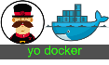
public registry
VM Scale Sets
Azure Container Service
Azure Hosted Docker Private Registry
ASP.NET
Test
Visual Studio Team Services
Azure Hosted Private Registry*
Source Code Control
Build
Continuous Integration
3rd Party Integration:
Azure Container Service
Staging
VSTS Build Agents w/ Docker
Orchestration & Scheduling - Marathon / Docker Swarm
Visual Studio
Integration
ASP.NET
In Container Development
Edit & Refresh
Breakpoint Debugging
Production
Debug
Write/Edit
Run
Visual Studio Code
Docker Language Services
Docker Scaffolding w/yo docker

Slide 46
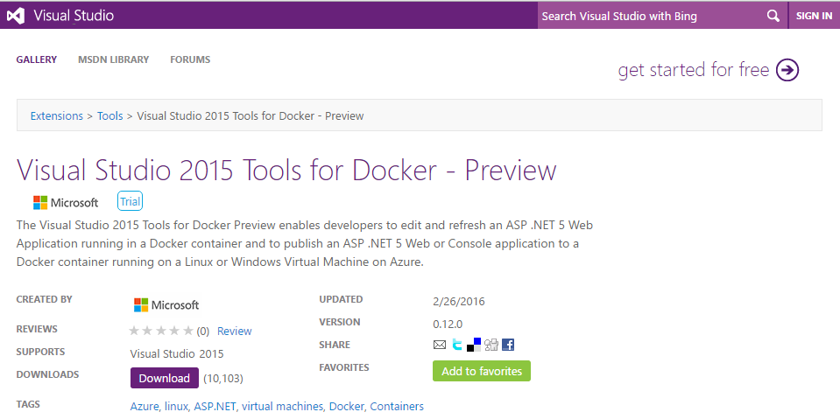
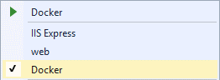
Docker Tools for Visual Studio
Scaffolds docker assets
Dockerfile, docker-compose.yml, DockerTask.ps1
Run and Test your code in a docker container
Linux today, Windows Server & Nano Server coming soon
Edit & Refresh of code
Enable F5 – Start Debugging

Slide 47
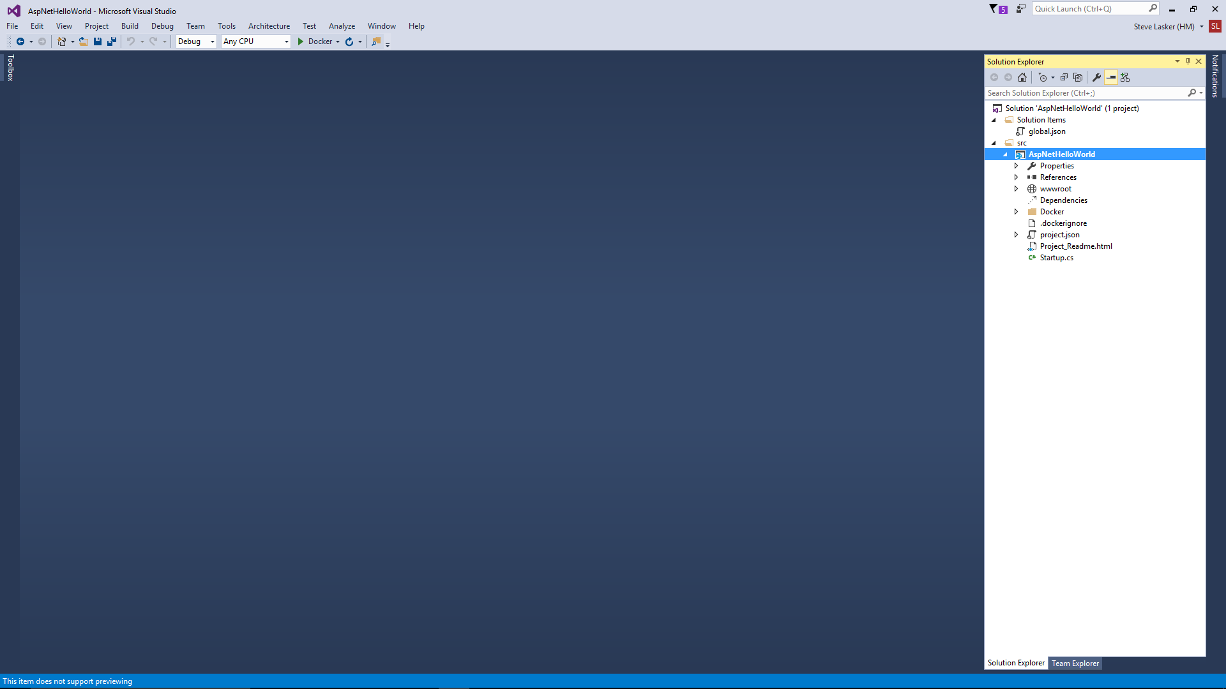
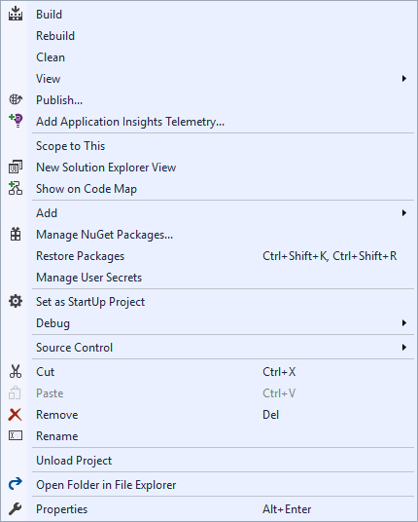
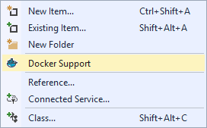
Docker Tools for Visual Studio

Slide 48

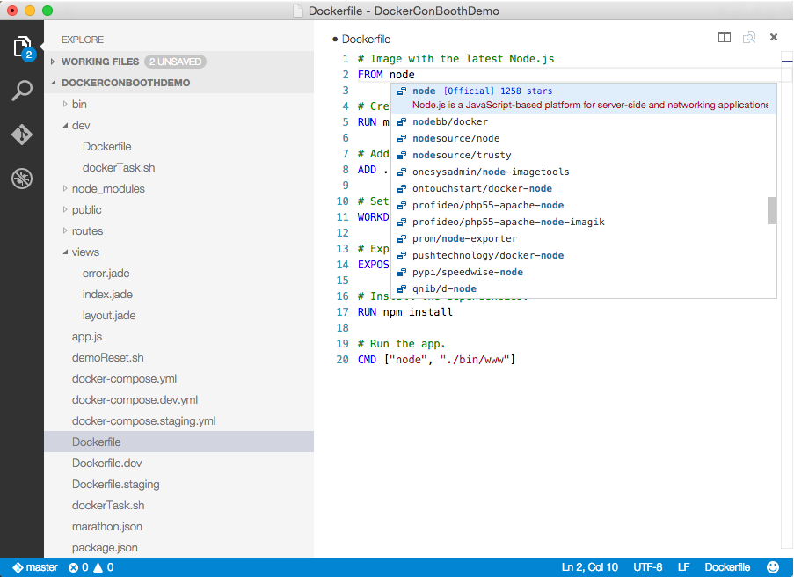
Visual Studio Code
OS X, Linux, Windows
Lightweight, keyboard focused
IntelliSense, GoTo Def, refactoring
Git SCC integration
Extensible platform
Docker Asset Editing - extension
aka.ms/VSCode
aka.ms/DockerToolsForVSCode

Slide 49
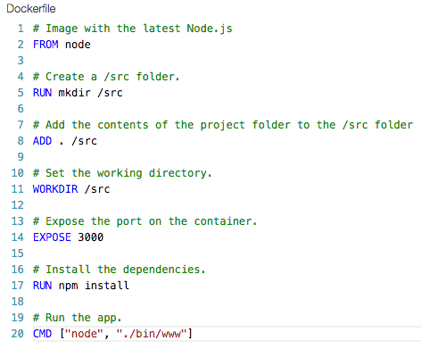
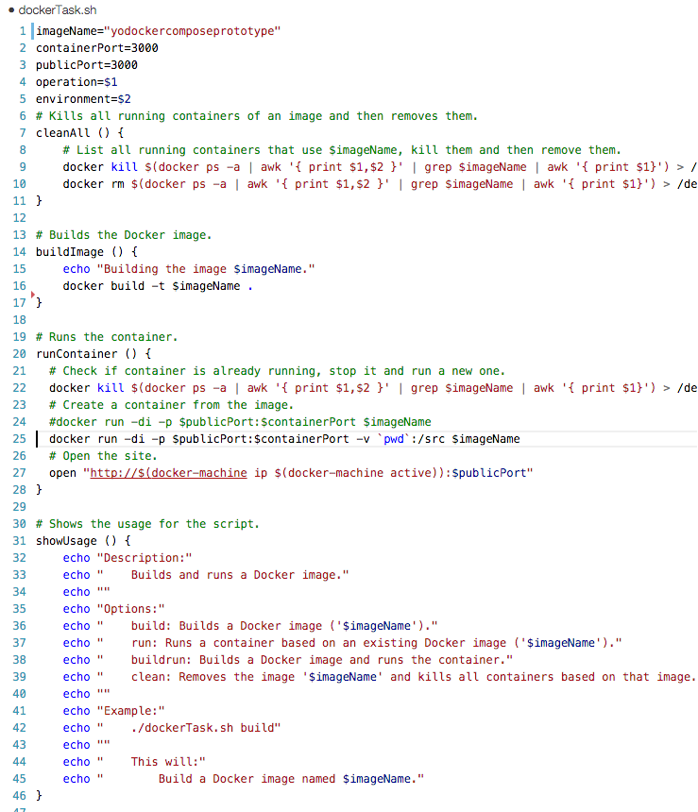
Bootstrapping the developer
Developers need a means to get started
Scaffolds initial assets
(Dockerfile.*, docker-compose.*.yml, bash and powershell scripts)
yo docker
aka.ms/YoDocker
Notes:
· Dev Tools (Steve Lasker)
· Docker support
· Test locally
· Deploy to Azure
· How do create an infrastructure in Azure to deploy to
TODO: possibly add docker-compose.yml image to show support for prod environemnt defintion

Slide 50
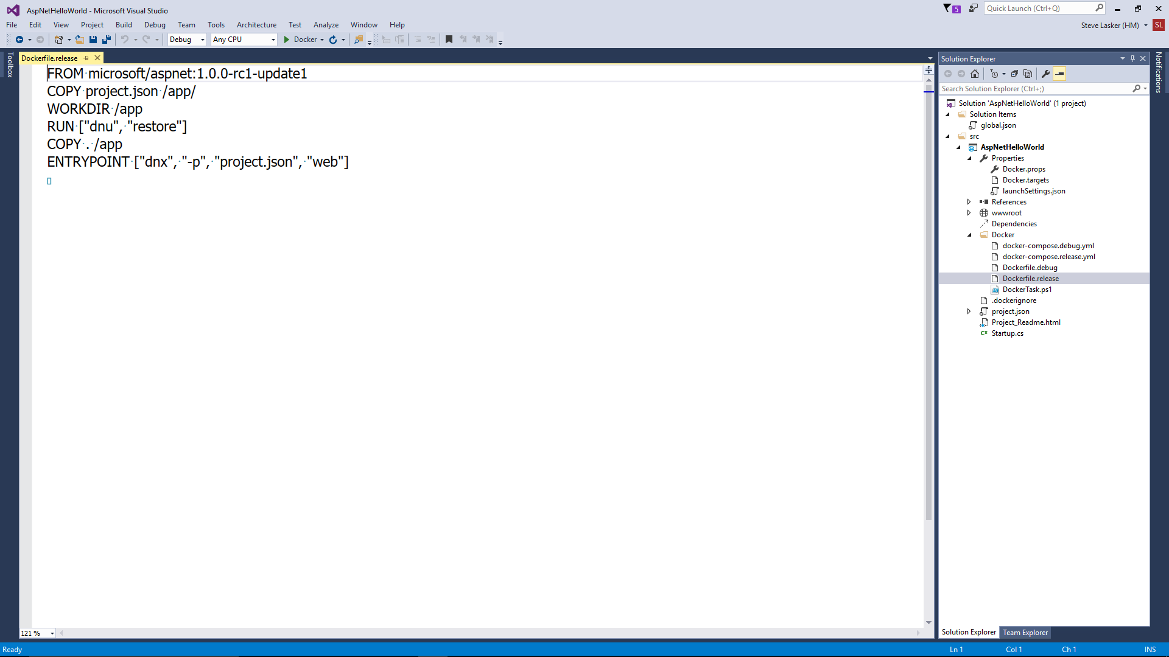
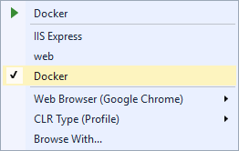
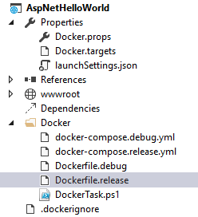
.dockerignore
Used by docker build and docker-compose build. Tells the docker runtime to ignore certain files from being copied to the container..
Docker.targets & Docker.props
Used by Visual Studio to hook the F5 experience
launchSettings.json
Docker entry point added to enable running in a Docker Container.
Dockerfile.debug
Builds an image, ready for debugging
Dockerfile.release
Release version, some optimizations removed. Release behavior for validations.
Docker-compose.debug.yml
Additional containers, with debugging support
Docker-compose.release.yml
Additional containers, with release behavior
DockerTask.ps1
PowerShell, to coordinate all the local operations. Similar to a makefile

Slide 51
Visual Studio Team Services
Docker “Steps” to aide in your build, validate, push scenarios
Integrated with:
GitHub for SCC
Jenkins for CI/CD
aka.ms/DockerToolsForVSTS

Slide 52
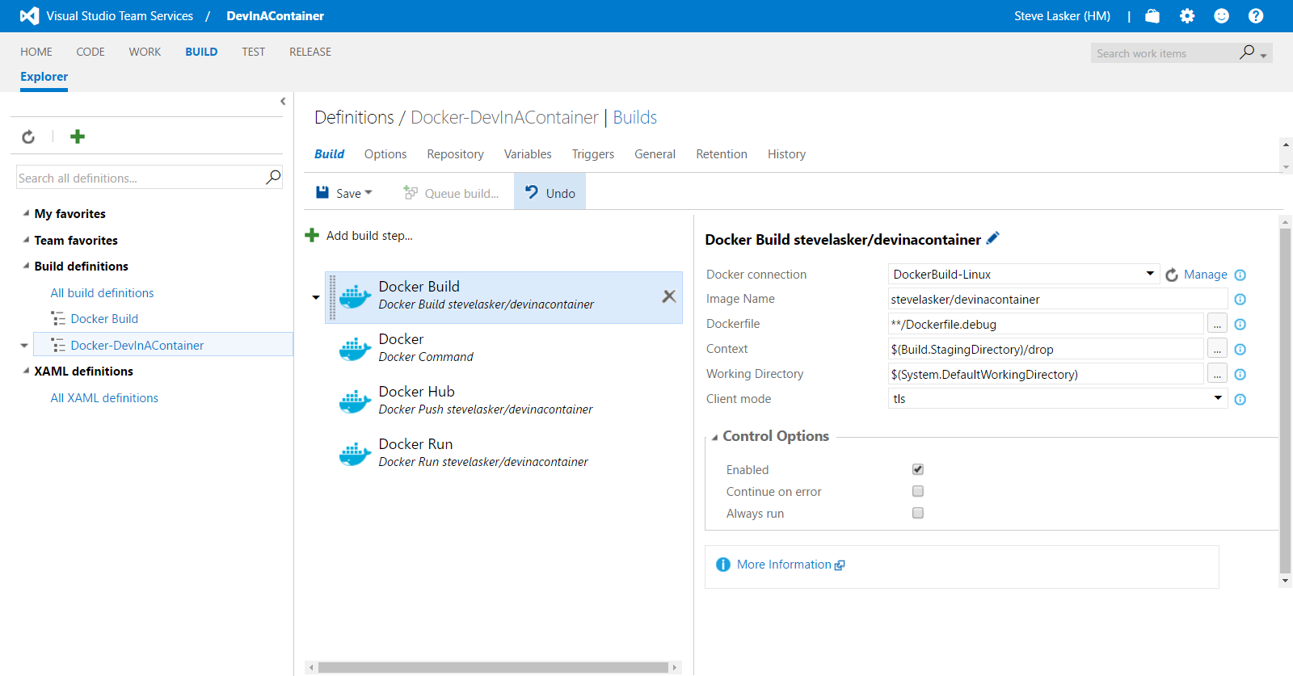
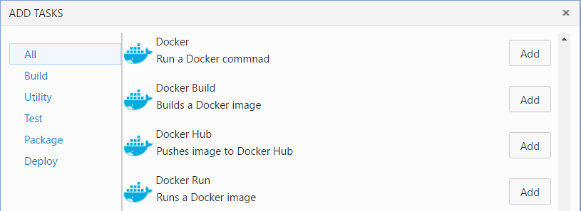

Slide 53
OS & Tooling Support for .NET
.NET Version/OS | Windows Server Core 2016 | Nano Server 2016 | Linux | VS | VS Code/Mac
.NET Full Framework (3.5-4.6) |  | N/A |  |  | N/A
.NET Core 1.0
Tooling for Windows Server & Nano Server coming soon
Including .NET Full FX and .NET Core

Slide 54
Azure Container Service A platform for reliable, hyperscale, container-based applications
Microservices
Flexible programming models
Open Source Orchestration
Azure Container Service
Host cluster management
Container hosts as cattle
Hyper-Scale
High Availability
High Availability
High Density
Open Source Container Management
Placement Constraints
Fast startup & shutdown
Self-healing
Azure
Private cloud
Other clouds
Notes:
Azure Container Service focusses on the configuration and management of the hosting infrastructure. We also provide key open source orchestration technologies. ACS does not provide an application development model. This has some advantages (e.g. more flexibility in application architecture) but some disadvantages (e.g. stateful applications need to be designed to manage their own state)

Slide 55
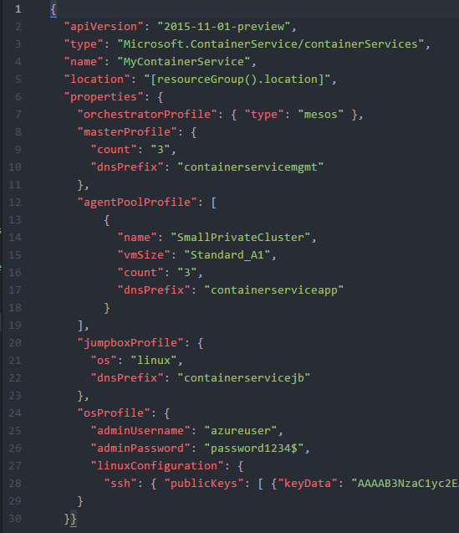
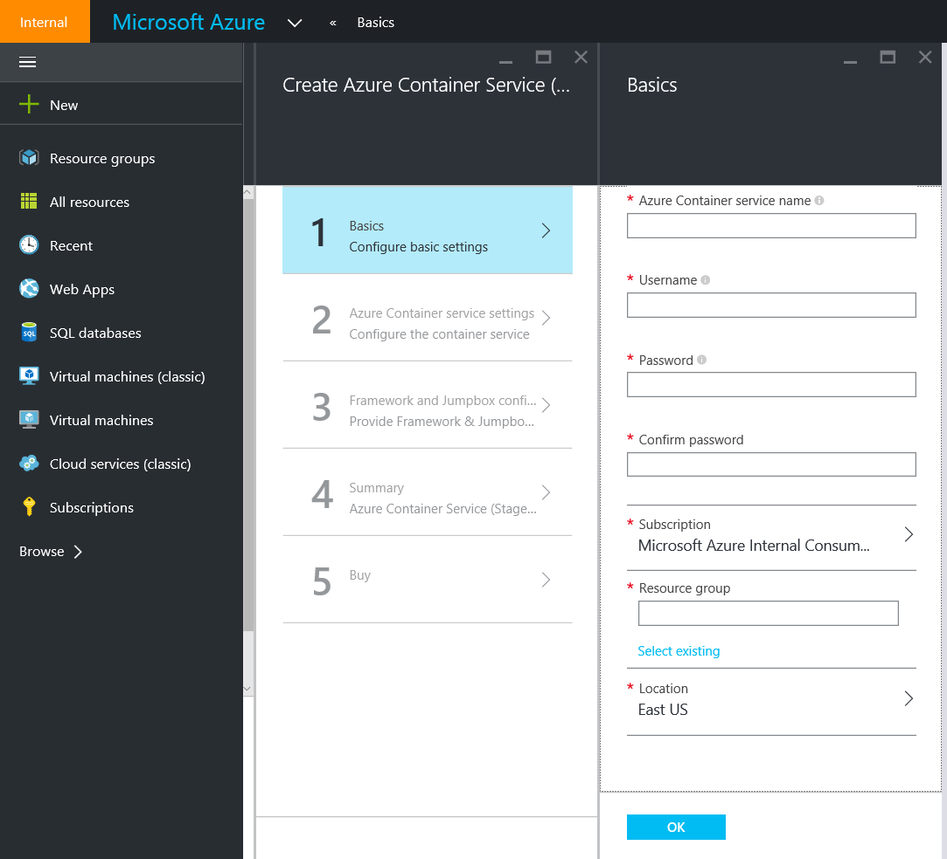
Deploy using Portal or ARM

Slide 56
Containers: a first class ARM resource
New Resource Provider
Defines required resources
Layered approach
Agility to track innovation
Community defined
Open Source and Open APIs
Portability
Hosts become cattle
No need to manage them
Containers are pets or cattle
Depending on application
Layer | Supported Technologies (2015)
Configuration as Code | ARM, Dockerfile, Docker Compose
Host cluster management | VM Scale Sets
Container orchestration | Docker Swarm, Chronos, Marathon, Apache Mesos
Monitoring | OMS, App Insights

Slide 57
Vocabulary
Agent
Client
Compose
Container
Dockerfile
Host
Image
Master
Orchestrator
Registry
Scaffold
Scheduler
Slave
Tag
Volume
Layers
Labels
Registry
Swarm
Container Services
Tags
Service
Ports
Commands
Docker-Machine Create, Env, Ip, Start, Restart, Active
Docker build, login, pull, push, run, search, tag
Docker-Compose Up, Build, Scale

Slide 58
Coming Into Port
Learned a new vocabulary
Explored the Container Workflow
Container Architecture & Deployment Differences
Explored some products to assist:
Docker Toolbox
Visual Studio
Visual Studio Team System
Azure Container Service
Had a little fun along the way

Slide 59
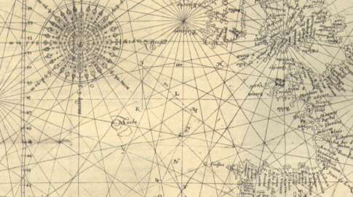
References:
aka.ms/DockerToolsForVS
aka.ms/DockerToolsForVSCode
aka.ms/DockerToolsForVSTS
aka.ms/yodocker
aka.ms/AzureContainerService
aka.ms/WindowsContainers
github.com/SteveLasker/Presentations/VSLive2016
Steve Lasker
@SteveLasker
blogs.msdn.com/SteveLasker
Steve.Lasker@Microsoft.com

